Slide 1
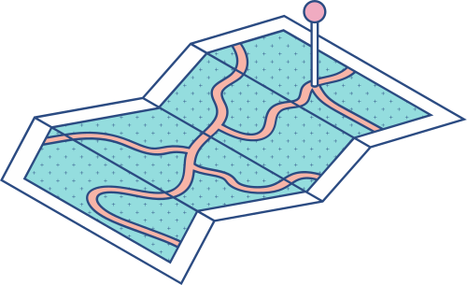





SECP3133-HDPD PROJECT 1 SEC 01
Optimizing Multithreaded Web Scraping (NST News) and Data Processing with Pandas, Dask, and Polars
LEE YIK HONG
A21BE0376
WONG JUN JI
A22EC0117
Lecturer: PROF. MADYA. TS. DR. MOHD SHAHIZAN BIN OTHMAN
CHE MARHUMI BIN CHE AB RAHIM
A22EC0147

Slide 2


INTRODUCTION
New Straits Times (NST) — specifically the Business, World, and ASEAN sections.
Specifically the Business, World, and ASEAN sections.
Selenium combined with multithreading to enable fast and parallel scraping.
Category, Headline, Summary, and Date, storing the results in a structured CSV format.
Processing time, CPU & memory usage, and throughput.

Slide 3

PROJECT OVERVIEW & OBJECTIVES
Problem
Solution
❌ Sequential and Resource-Heavy
Most traditional scrapers:
Load one page at a time (no parallelism)
Render full pages (including images, CSS, and fonts)
Fail or timeout with JavaScript-heavy websites (like NST)
Optimization-Focused Web Scraper (Selenium + Threading + Blocking Resources)
Optimization | Description | Benefit
🧵 Multithreading | Uses 4 threads to scrape pages concurrently | 🚀 Speeds up scraping by 2x–5x
🧼 Selective Data Extraction | Only grabs required fields: headline, category, summary, date | 🎯 Avoids unnecessary data
🎭 Headless Mode | Runs browser without UI | 🧠 Saves memory and CPU
🚫 Blocked Resources | Blocks images, fonts, CSS | ⚡ Faster page load
Objective
Develop efficient, scalable web scraping.
Structured data extraction (Category, Headline, Summary, Date).
Apply data cleaning using Pandas, Dask, and Polars.
Implement performance benchmarking.

Slide 4
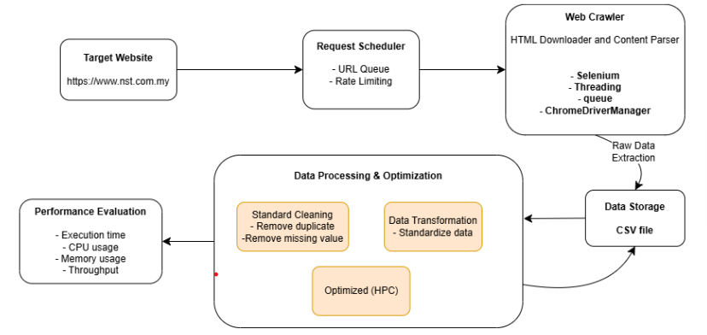
System Architecture

Slide 5
Duplicate Removal
• Some articles appear more than once under different categories. • Duplicates are removed to ensure uniqueness.
Handle Missing/Empty Data
Empty headlines are removed. Missing summaries are filled. Ensures consistency and data quality.
Cleaning Methods

Slide 6
Input Format
Raw scraped data loaded from a CSV file.
Output Format
Cleaned and structured data saved as CSV.
Final Data Fields
Data Structure
Category
Headline
Summary
Date
Place
Year
Month

Slide 7
Duplicate Removal
• Some articles appear more than once under different categories. • Duplicates are removed to ensure uniqueness.
Handle Missing/Empty Data
Empty headlines are removed. Missing summaries are filled. Ensures consistency and data quality.
Cleaning Methods

Slide 8



Optimisation Technique

Slide 9
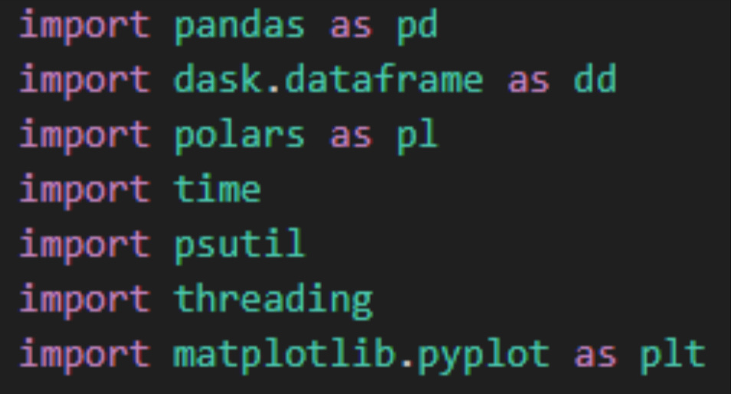
Import Required Libraries
THE PROJECT BEGINS BY IMPORTING ESSENTIAL LIBRARIES FOR DATA PROCESSING, RESOURCE MONITORING, CONCURRENCY AND VISUALIZATION:

Slide 10
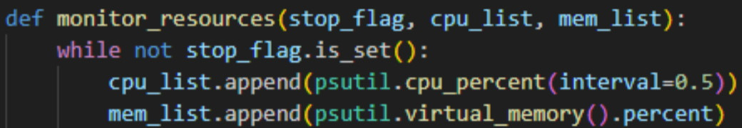
Resource Monitoring and Performance Measurement
A MONITORING THREAD COLLECTS CPU AND MEMORY USAGE PERIODICALLY TO CAPTURE SYSTEM RESOURCE USAGE DURING EXECUTION

Slide 11
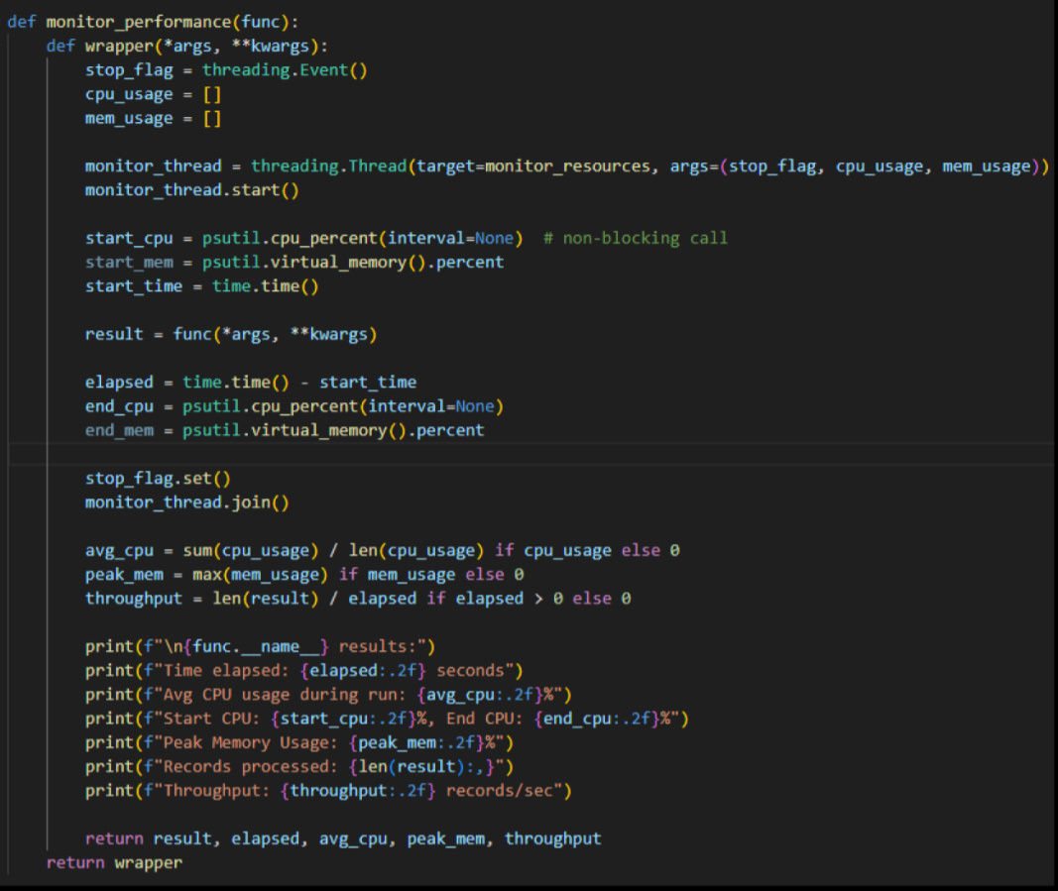
A DECORATOR NAMED MONITOR_PERFORMANCE WRAPS THE CLEANING FUNCTIONS TO MEASURE THE TOTAL EXECUTION TIME, AVERAGE CPU USAGE, PEAK MEMORY USAGE, AND ALSO THE THROUGHPUT.

Slide 12
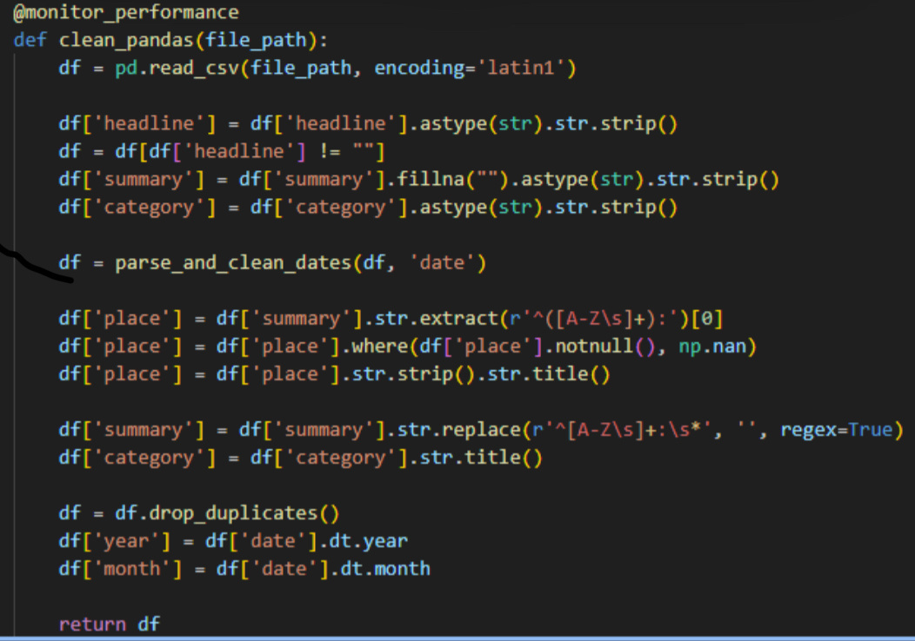
Data Cleaning Functions for Each Library
PANDAS CLEANING PIPELINE

Slide 13
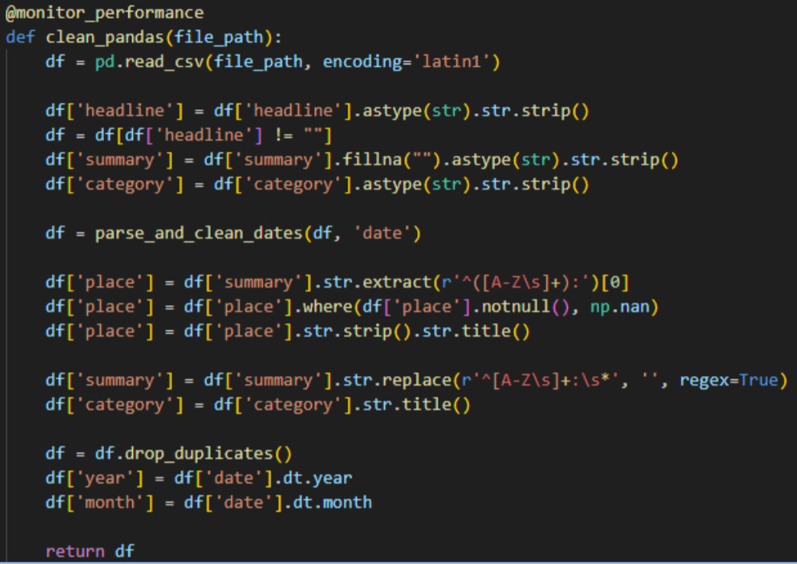
DASK CLEANING PIPELINE

Slide 14
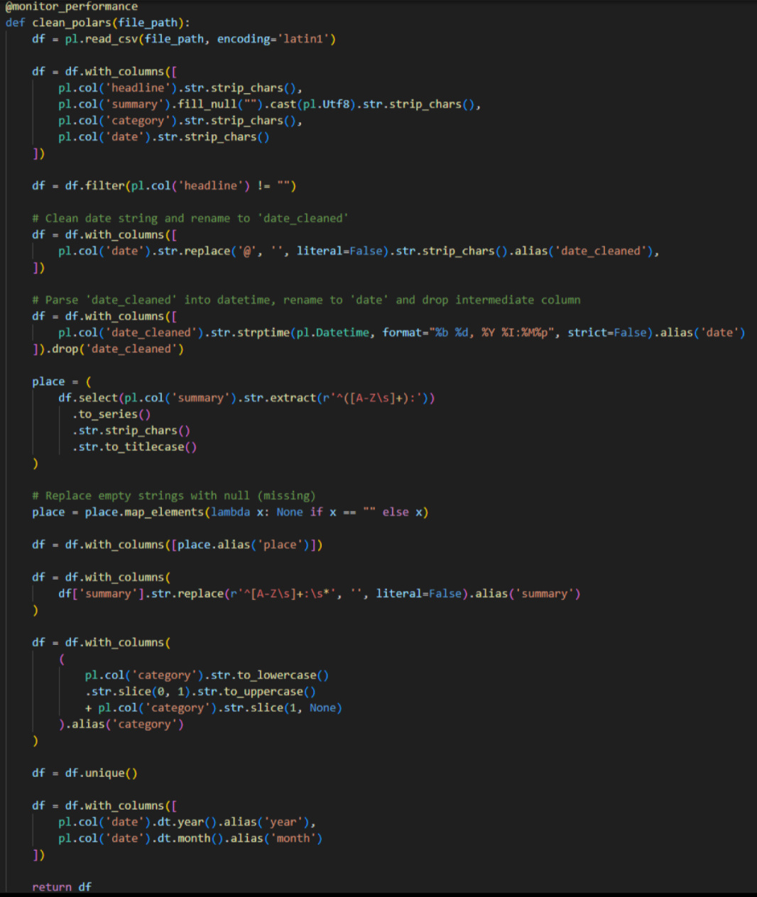
POLAR CLEANING PIPELINE

Slide 15
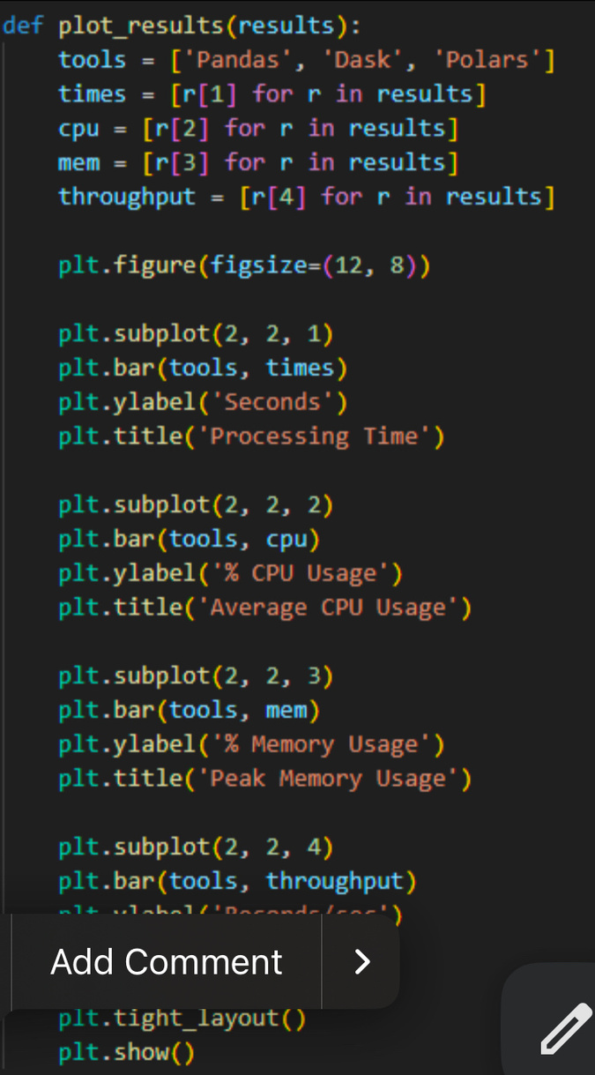
Visualization of Performance Metrics
A PLOTTING FUNCTION THAT DISPLAYS BAR CHARTS COMPARING PROCESSING TIME, AVERAGE CPU USAGE, PEAK MEMORY USAGE, AND THROUGHPUT FOR THE THREE LIBRARIES

Slide 16
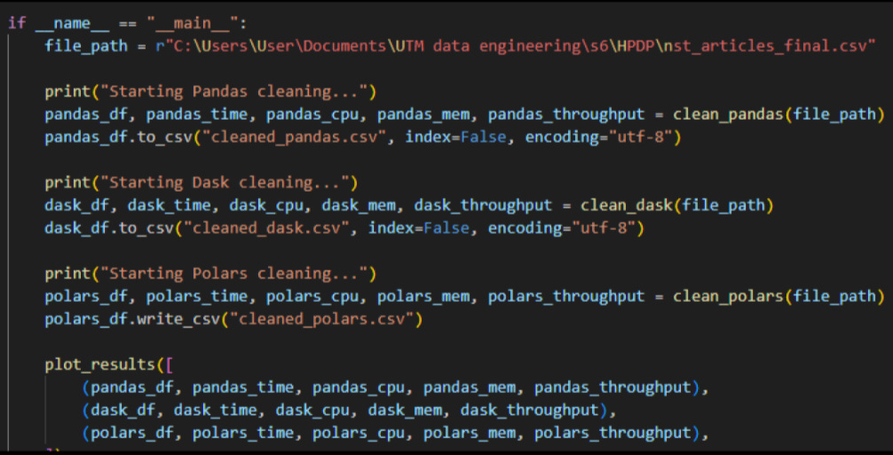
THE MAIN SCRIPT THAT EXECUTES EACH CLEANING FUNCTION SEQUENTIALLY, SAVES CLEANED DATA FILES, AND VISUALIZES THE PERFORMANCE METRICS
Execution Flow

Slide 17
Performance Evaluation
Metric | Pandas | Dask | Polars
Time Elapsed (s) | 1.30 | 1.56 | 0.19
Average CPU Usage (%) | 31.03 | 27.37 | 28.90
Peak Memory Usage (%) | 71.50 | 73.60 | 73.30
Throughput (records/sec) | 77550 | 64766 | 529123
Records Processed | 100962 | 100962 | 100962

Slide 18
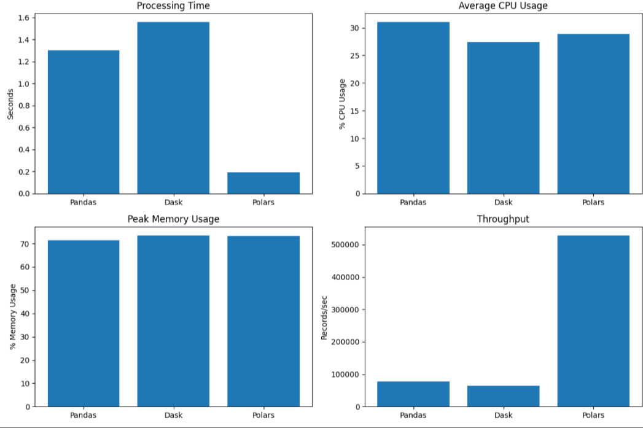
Visualisation

Slide 19

Challenges & Limitations
WHAT CHALLENGES DID WE FACED DURING THIS PROJECT?
Target Website Selection and Scraping Challenges | Tooling and Environment Constraints | Data Cleaning And Transformation Challenge
The team faced significant challenges in scraping the website due to strong anti-scraping defenses | Compatibility issues and resource limitations | Maintaining consistency and accuracy while performing data cleaning and transformation

Slide 20
Future Work
Conclusion
Use distributed scraping (e.g. Playwright).
Store data in databases instead of CSV.
Try real-time scraping for faster updates.
Aim to make the system more scalable and flexible.
• Built a fast multithreaded web scraper using Selenium.
• Collected 100,000+ articles from the NST website.
• Polars processed data fastest (>500,000 records/sec).
• Faced and solved issues like site restrictions and setup problems.

